Slide 1

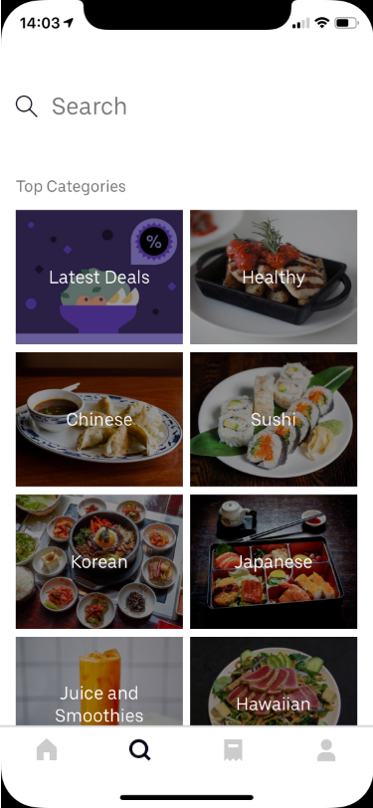
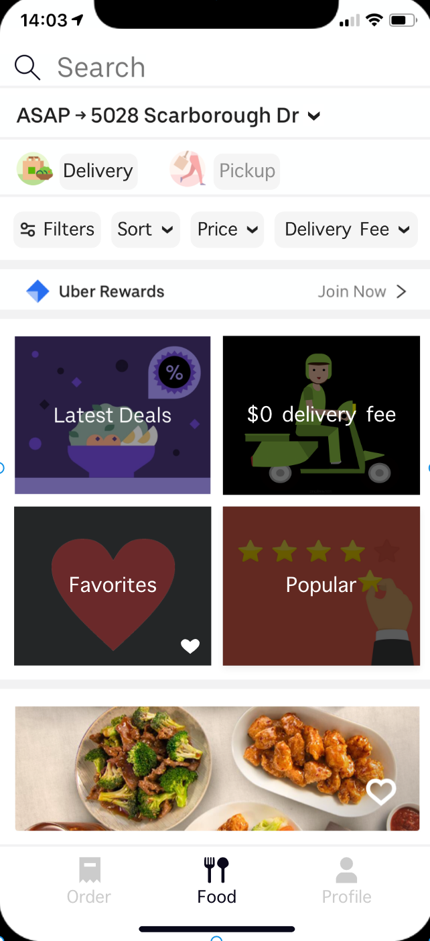
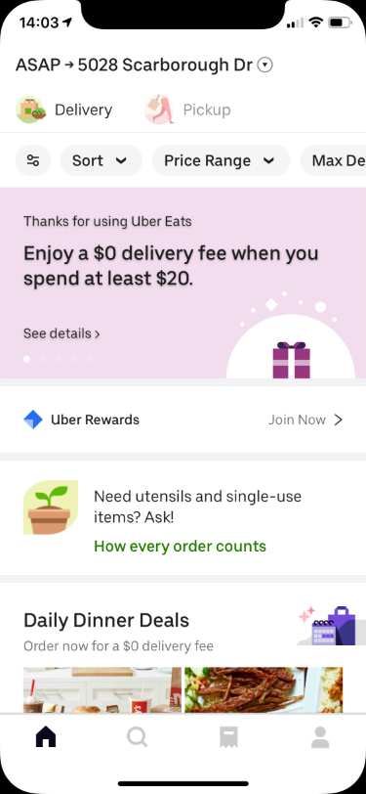
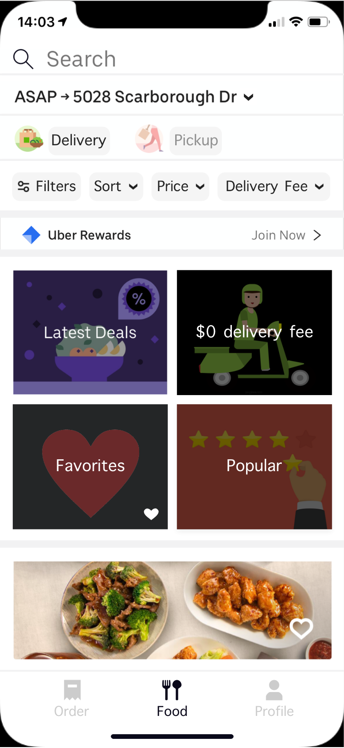
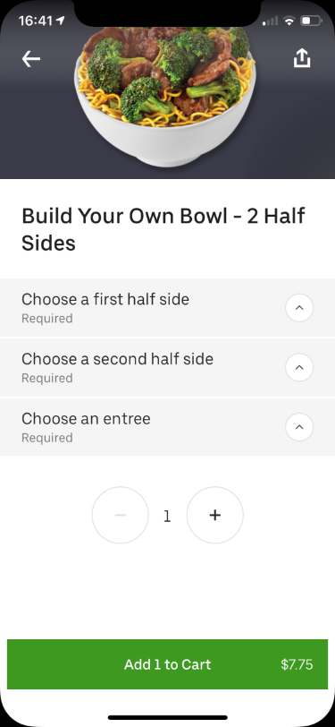
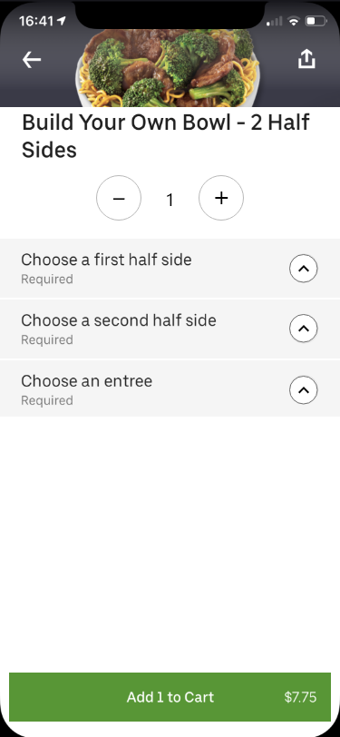
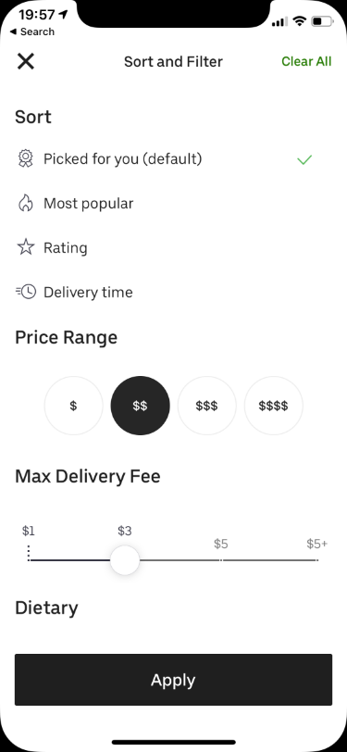
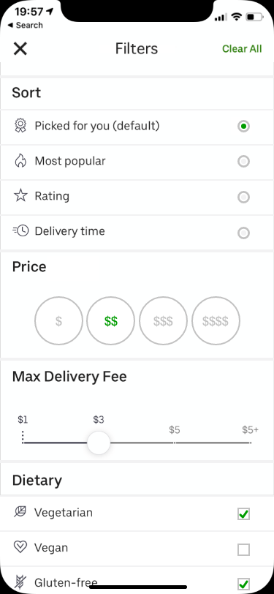
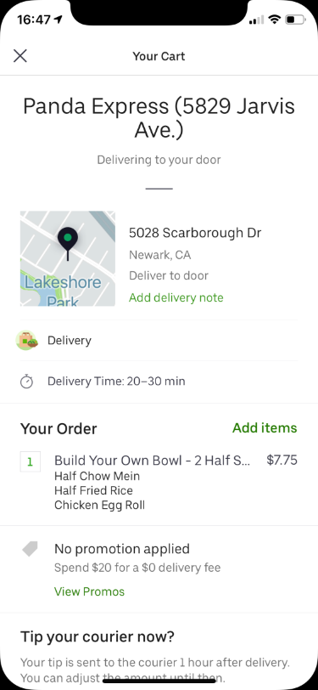
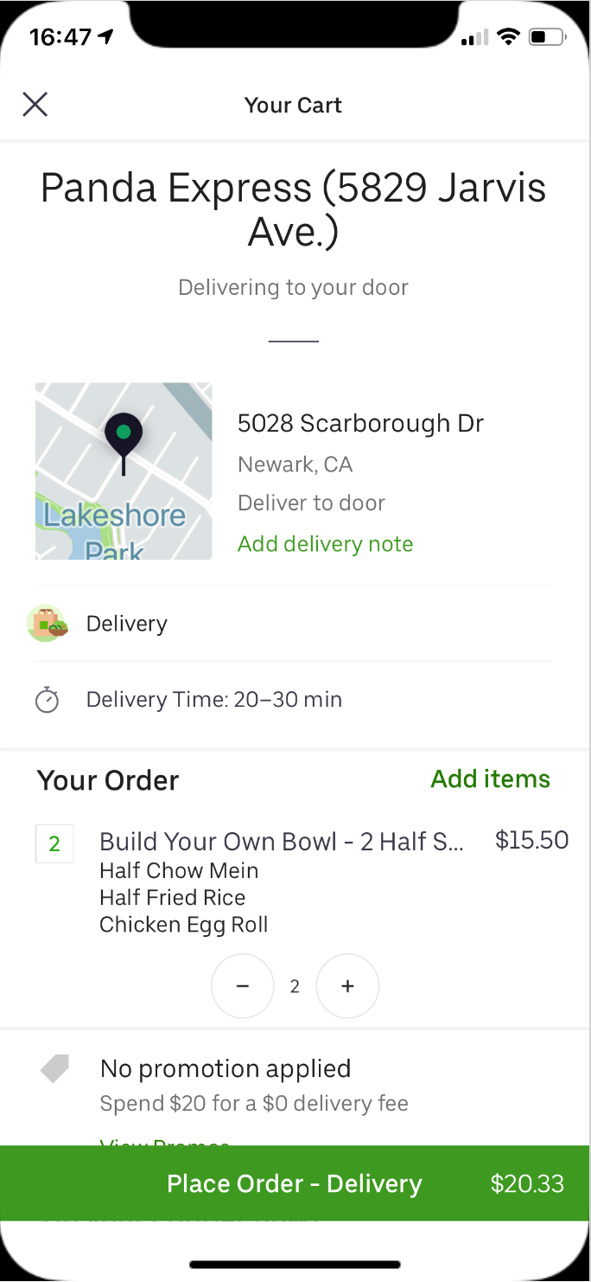
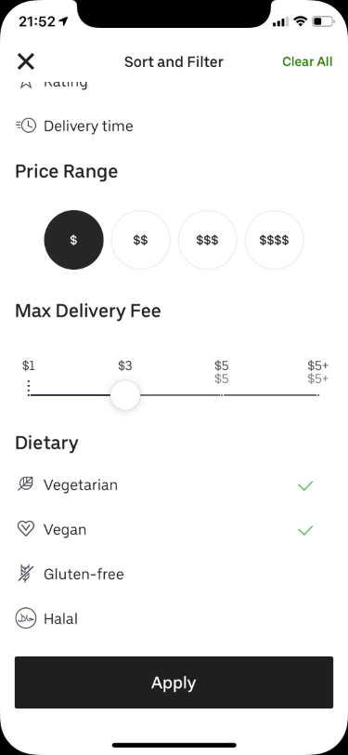
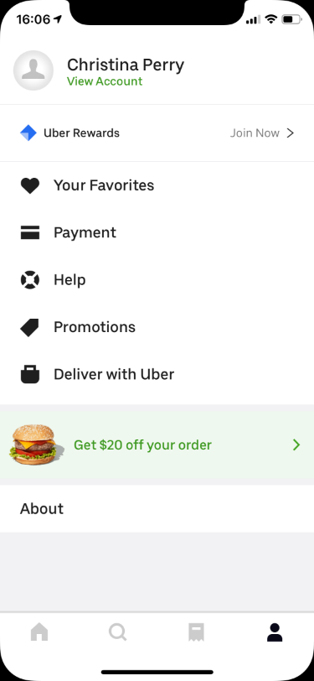
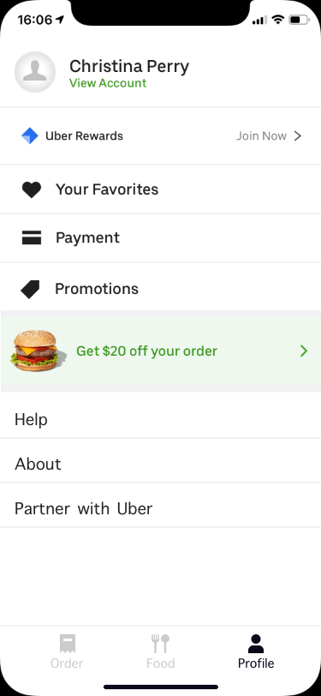
Uber Eats Redesign and Revaluation
Team Sappers
ISE 217/CMPE 217 Section 02, Fall 2019
Namrata Kasar
Christina Perry
Chaithra Lakshmi Sathyanarayana
Shivam Tyagi
Introduction
Prototype
Usability Testing
5 Participants, students in their 20’s participated in the Usability Testing. They were asked to complete the following tasks:
Task 1: From the home screen, search for restaurants based on your selected address.
Task 2: From the home screen, filter the restaurants using available filter options.
Task 3: From the home screen, get latest deals on restaurants or popular restaurants.
Task 4: Select a restaurant and order from it.
Task 5: Change the quantity of selected food items during order process.
User metrics used for evaluation : easy to learn, to measure the usability by recording the time required by participants to complete above tasks.
Uber Eats lets people order food online, and provide them options to either get it delivered or picked up.
Uber Eats provides easy interface for users to find restaurants nearby, select from restaurants’ menu and order food online.
Users can pay for the orders using multiple options like debit/credit card, paypal, Uber-cash among others.
Users can track their orders after ordering their food.
Change 1: Merged Home and Search page by providing search bar and filter options on the Home page.
Change 2: Grouped sections appearing on the Home page in between the list of restaurants into 4 major categories which are: Latest Deals, 0 deliver fees, Favourites and Popular
Goals Of Redesigning
Change 3: Filter, Price and Max Delivery Fee tabs renamed.
Change 4: Redesigned the bottom navigation bar to provide user with distinct options to determine further actions.
Uber Eats is growing its popularity compared to other food delivery apps among the customers. Though Uber Eats has its website offering same features as the mobile app, most of the orders on Uber Eats are received from the mobile app. Uber Eats needs to improve the design and user experience for their mobile application.
Help users to easily search for restaurants and the restaurants’ menu in less time
Provide users better navigation for the app features such as home, searching restaurants and order history.
Fig 1. Home & Search Page
Fig 2. Filter and Bottom Navigation Bar
Change 5: Quantity button moved to top and resized the food image into half.
This provides more space for expanding the options. The fixed quantity button at the top, helps user to change and keep track of selected quantity at any time.
Results
Change 6: Checkmark to Radio Button.
Task 1:
Uber Eats: Took comparatively longer time
Prototype: Easy to use and took less time.
Task 2:
Uber Eats: Difficulty in distinguishing the selected filters
Prototype: Easy to recognize the selected filters
Task 3:
Uber Eats: Took comparatively longer time
Prototype: Easy to use and took less time
Task 4:
Uber Eats: Difficulty in changing the quantity of items
Prototype: Easy to order
Task 5:
Uber Eats: Difficulty in changing the quantity of items
Prototype: Easy to change quantity at any time during order process.
Fig 3. Quantity Buttons
Change 7: Better Price range selection.
Suggested Enhancements
Change 9: Quantity buttons in Cart itself.
Now the user can easily increase quantity, instead of selecting the quantity to get options to increase quantity
Change 10: Place order button is fixed and can be seen from everywhere. The user does not have to scroll to the bottom of the page to place delivery
Change 8: Checkmark to Checkbox.
Changing bottom navigation bar options
Merging Home and search page.
Re-grouping sub sections together in home page.
Grouping the actions in profile page
Making design consistent with respect to button colors.
Adding visible dividers between items.
Adding add/remove quantity option in cart screen
Grouping “Deliver with Uber” option differently.
Making clickable tabs distinctly visible.
Making color scheme of buttons consistent.
Clarity in filter options.
Fig 5. Quantity and Delivery Button on Order Page
Fig 4. Cart and Tip Options
Important Focus Points
Making clickable options more visible and distinct.
Merging Home and Search pages to remove redundancy.
Floating the Quantity options to make it more convenient to change quantity during Order Process.
Quantity options for each item in the cart so that user can change the quantity then and there rather than going back to menu page to do it.
Conclusion
The improvements made to the UberEats mobile app improved the usability of the app. Participants completed with more ease and less errors in the presented prototype compared to existing UberEats mobile app.
Change 11: Better grouping of Profile options and made them more distinct.
Key References
Fig 6. Profile Page
https://media.thinknum.com/articles/people-love-uber-eats-a-lot/

Slide 2
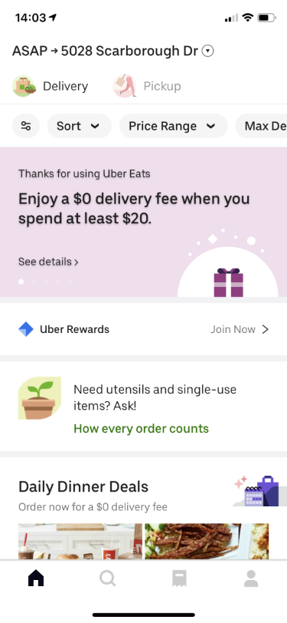
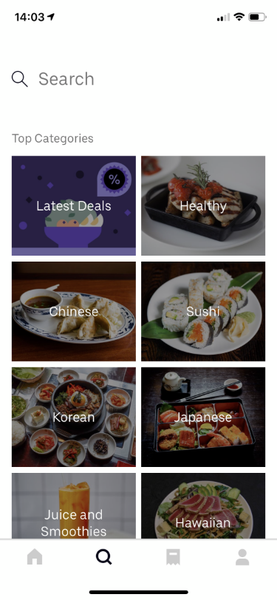

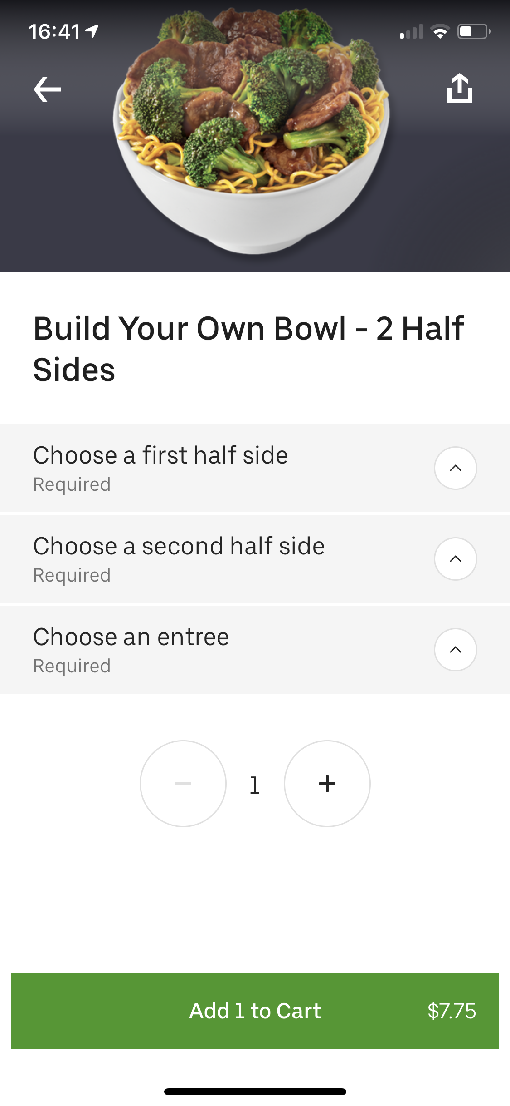

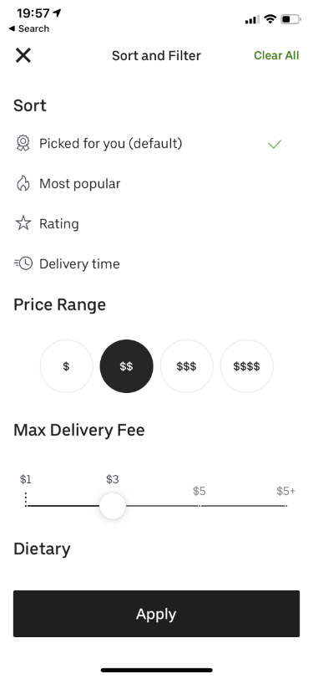
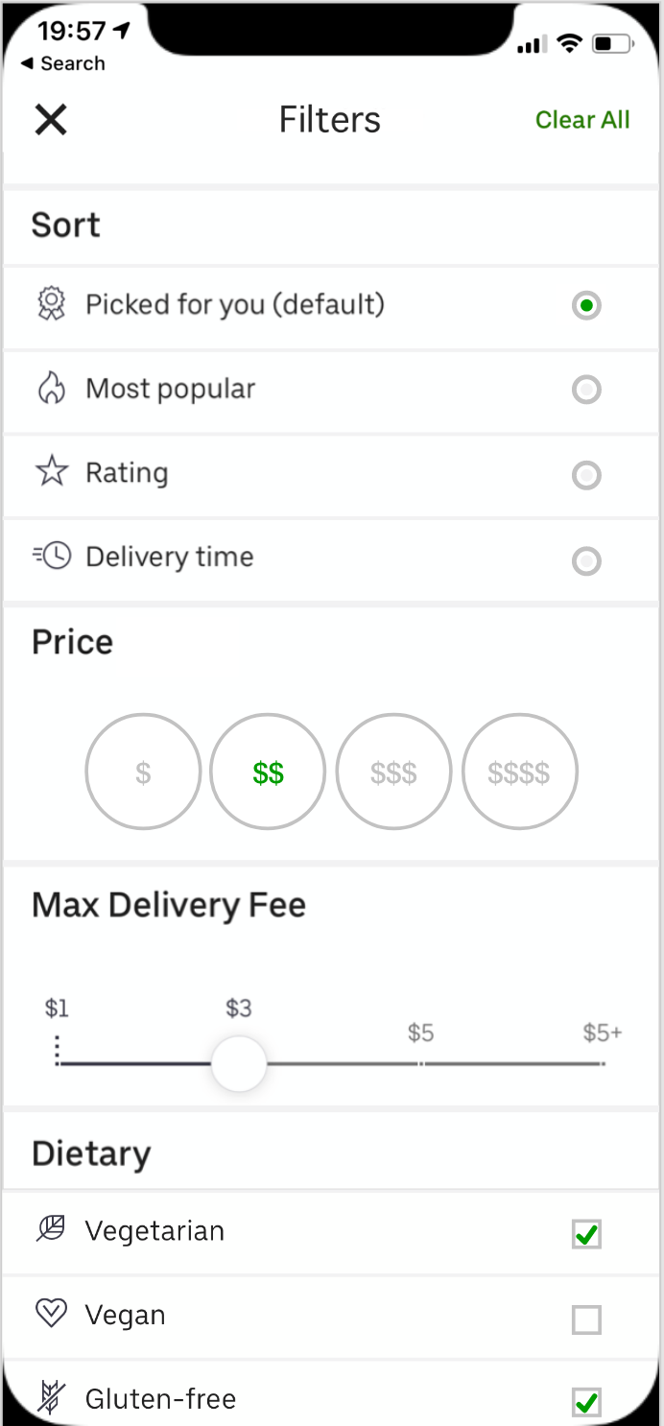
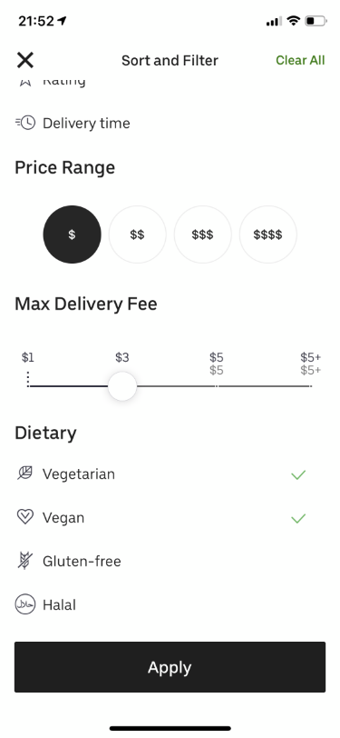
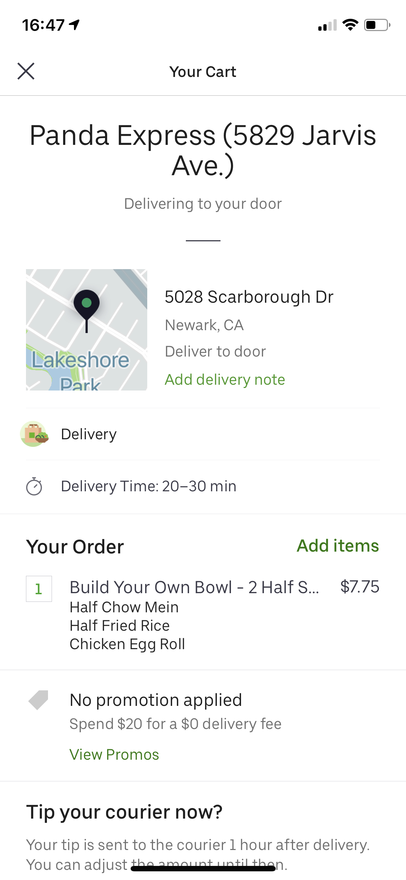
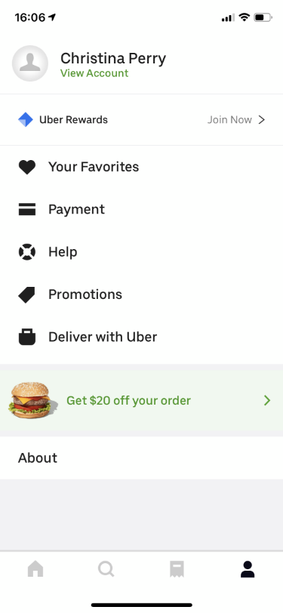
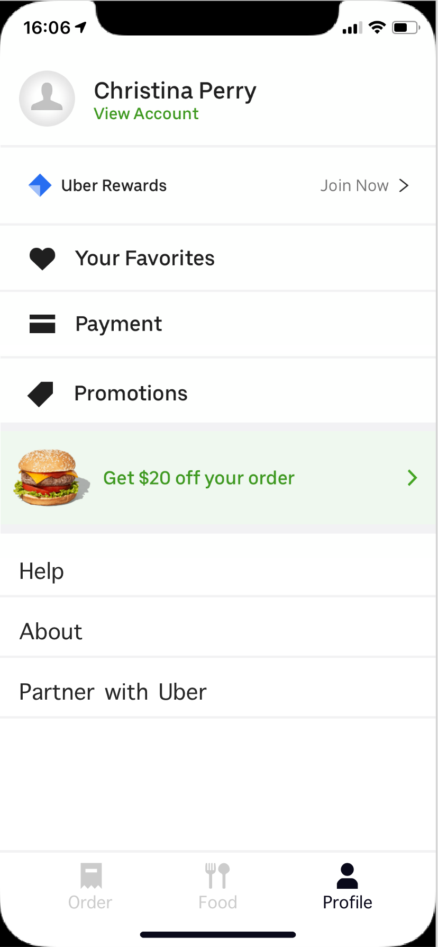
Uber Eats Redesign and Revaluation
Team Sappers
ISE 217/CMPE 217 Section 02, Fall 2019
Namrata Kasar
Christina Perry
Chaithra Lakshmi Sathyanarayana
Shivam Tyagi
Introduction
Prototype
Usability Testing
Uber Eats lets people order food online, and provide them options to either get it delivered or picked up.
Uber Eats provides easy interface for users to find restaurants nearby, select from restaurants’ menu and order food online.
Users can pay for the orders using multiple options like debit/credit card, paypal, Uber-cash among others.
Users can track their orders after ordering their food.
5 Participants, students in their 20’s participated in the Usability Testing. They were asked to complete the following tasks:
Task 1: From the home screen, search for restaurants based on your selected address.
Task 2: From the home screen, filter the restaurants using available filter options.
Task 3: From the home screen, get latest deals on restaurants or popular restaurants.
Task 4: Select a restaurant and order from it.
Task 5: Change the quantity of selected food items during order process.
User metrics used for evaluation : easy to learn, to measure the usability by recording the time required by participants to complete above tasks.
Change 1: Merged Home and Search page by providing search bar and filter options on the Home page.
Change 2: Grouped sections appearing on the Home page in between the list of restaurants into 4 major categories which are: Latest Deals, 0 deliver fees, Favourites and Popular
Goals Of Redesigning
Change 3: Filter, Price and Max Delivery Fee tabs renamed.
Change 4: Redesigned the bottom navigation bar to provide user with distinct options to determine further actions.
Uber Eats is growing its popularity compared to other food delivery apps among the customers. Though Uber Eats has its website offering same features as the mobile app, most of the orders on Uber Eats are received from the mobile app. Uber Eats needs to improve the design and user experience for their mobile application.
Help users to easily search for restaurants and the restaurants’ menu in less time
Provide users better navigation for the app features such as home, searching restaurants and order history.
Change 5: Quantity button moved to top and resized the food image into half.
This provides more space for expanding the options. The fixed quantity button at the top, helps user to change and keep track of selected quantity at any time.
Results
Task 1: From the home screen, search for restaurant based on your selected address.
Uber Eats: Took comparatively longer time
Prototype: Easy to use and took less time
Task 2: From the home screen, filter the restaurants using available filter options.
Uber Eats: Difficulty in distinguishing the selected filters
Prototype: Easy to recognize the selected filters
Task 3: From the home screen, get latest deals on restaurants or popular restaurants.
Uber Eats: Took comparatively longer time
Prototype: Easy to use and took less time
Task 4: Select a restaurant and order from it.
Uber Eats: Difficulty in changing the quantity of items
Prototype: Easy to order
Task 5: Change the quantity of selected food items during order process.
Uber Eats: Difficulty in changing the quantity of items
Prototype: Easy to change quantity at any time during order process.
Change 6 Checkmark to Radio Button.
Change 7: Better Price range selection.
Suggested Enhancements
Change 8: Checkmark to Checkbox.
Changing bottom navigation bar options
Merging Home and Search Page for better clarity of users.
Grouping and arranging all sub sections together in Home page.
Grouping the actions in profile page
Making design consistent with change in button colors and adding visible dividers.
Adding add/remove quantity option in Cart screen
Enabling the user to place delivery from anywhere on the cart screen
Grouping “Deliver with Uber” option differently.
Making clickable tabs distinctly visible.
Making delivery change time option more visible.
Making color scheme of buttons consistent.
Clarity in filter options.
Change 9: Quantity buttons in Cart itself.
Now there is no need to scroll till the bottom for adding quantity of a menu item.
Important Focus Points;
Making clickable options more visible and distinct.
Merging Home and Search pages to remove redundancy and confusion.
Floating the Quantity options to make it more convenient to change quantity during Order Process.
Quantity options for each item in the cart so that user can change the quantity then and there rather than going back to menu page to do it.
Conclusion
The improvements made to the UberEats mobile app improved the usability of the app. Participants completed with more ease and less errors in the presented prototype compared to existing UberEats mobile app.
Change 10: Better grouping of Profile options and made them more distinct.
Key References
https://media.thinknum.com/articles/people-love-uber-eats-a-lot/

